Slide 1

React JS
Understanding its power and influence

Slide 2
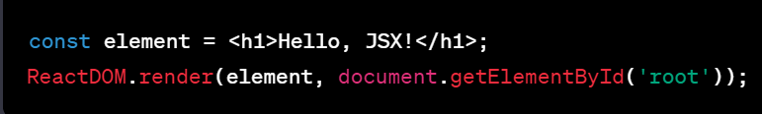
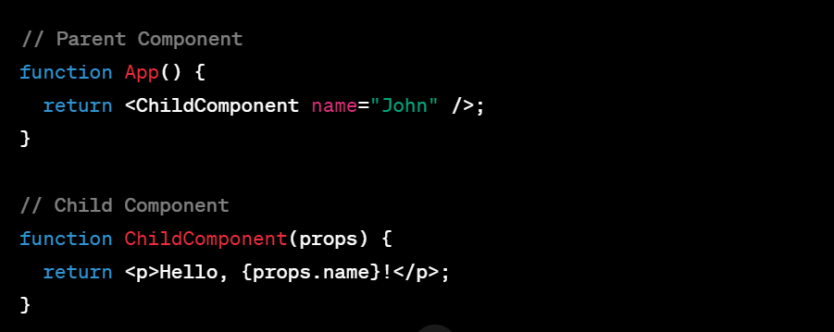
JSX (JavaScript XML) Syntax
Introduction to React
JSX allows you to write HTML in JavaScript, making it easier to express UI components. It's a syntax extension that resembles XML/HTML.
Virtual DOM
Components and Props
React applications are built using components, which are reusable, self-contained pieces of code.
Props are used to pass data from parent to child components.
React uses a virtual DOM to improve performance.
It's a lightweight copy of the actual DOM.
When the state of a React component changes, React first updates the virtual DOM,
It then efficiently updates only the necessary parts of the actual DOM.
Minimizes direct interaction with the real DOM, which is a computationally expensive operation.
Enhances performance by updating only the changed elements instead of re-rendering the entire DOM.

Slide 3

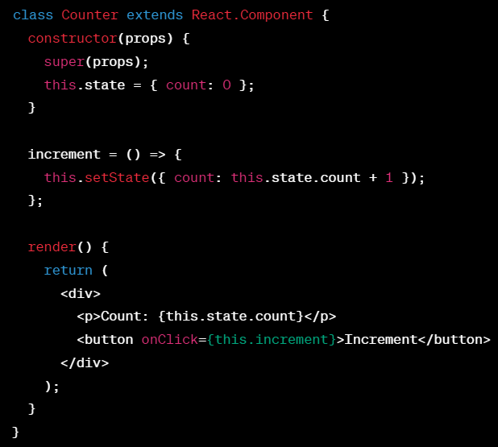

State and Lifecycle
Component State
State is a JavaScript object that stores component-specific data.
It is mutable and can be updated using the setState method.
Changes in state trigger re-rendering of the component.
State should be treated as immutable to avoid unexpected behavior.

Slide 4
constructor(props): Initializes the component's state and props.
static getDerivedStateFromProps(props, state): Used to update the state based on changes in props.
render(): Returns the JSX to be displayed on the screen.
componentDidMount(): Invoked after the component is added to the DOM.
shouldComponentUpdate(nextProps, next-state): Decides if the component should update based on changes in props
or state.
getSnapshotBeforeUpdate(prevProps, prevState): Captures a snapshot of the DOM before changes are applied.
componentDidUpdate(prevProps, prevState, snapshot): Called after the component updates and the DOM is rendered.
componentWillUnmount(): Invoked just before the component is removed from the DOM.
componentDidCatch(error, info): Catches errors in the child component tree.
Lifecycle Methods
Lifecycle methods enable developers to perform actions at specific points during a component's life cycle.

Slide 5
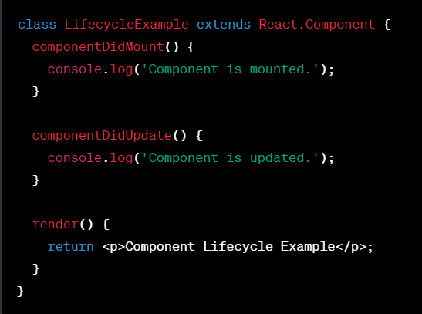
Lifecycle Methods
Lifecycle methods enable developers to perform actions at specific points during a component's life cycle.
ComponentDidMount:
Invoked immediately after a component is inserted into the DOM.
Ideal for initiating API requests or setting up subscriptions.
ComponentDidUpdate:
Called after the component is re-rendered.
Useful for handling updates, such as fetching new data based on prop changes.

Slide 6

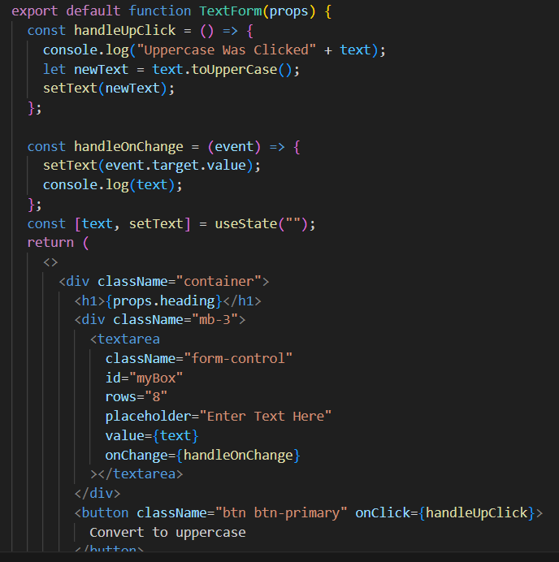
Handling Events in React
Handling events in React is similar to handling events in traditional HTML.
React events are synthetic wrappers around the native browser events, allowing consistent handling across different browsers.
You can pass additional data to an event handler by defining a function.

Slide 7
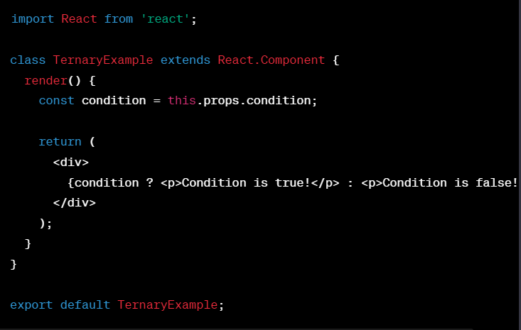
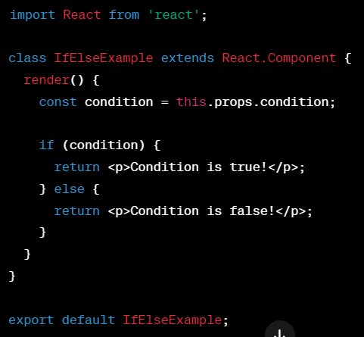
Conditional Rendering in React
React's conditional rendering is like the Batman of components: it knows when to swoop in and save the day by showing or hiding based on certain conditions.
Using Ternary Operator:
Using if-else:

Slide 8
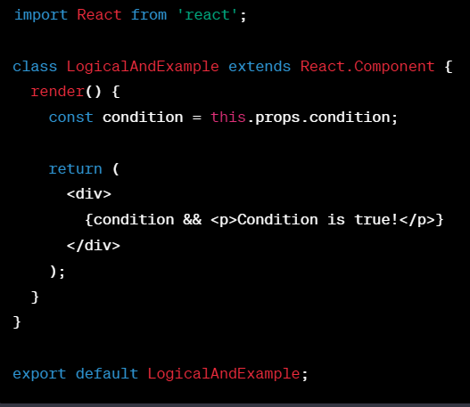
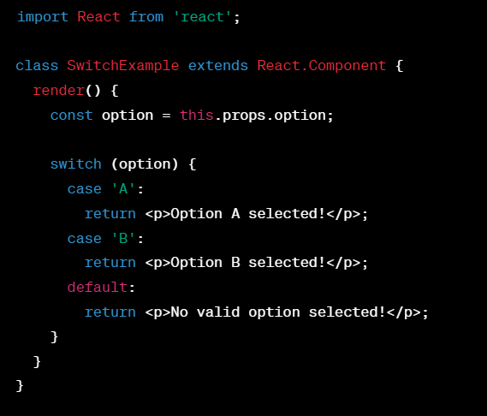
Conditional Rendering in React
React's conditional rendering is like the Batman of components: it knows when to swoop in and save the day by showing or hiding based on certain conditions.
Using Logical AND (&&):
Using Switch Statement:

Slide 9
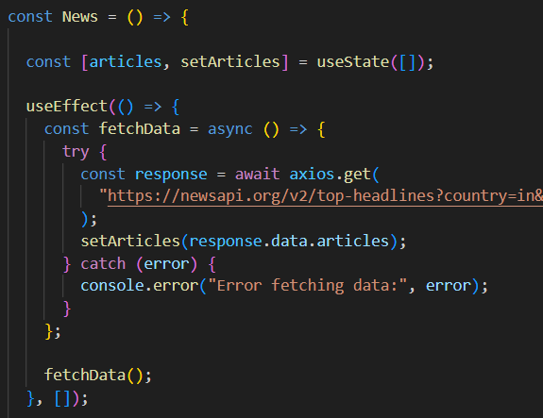
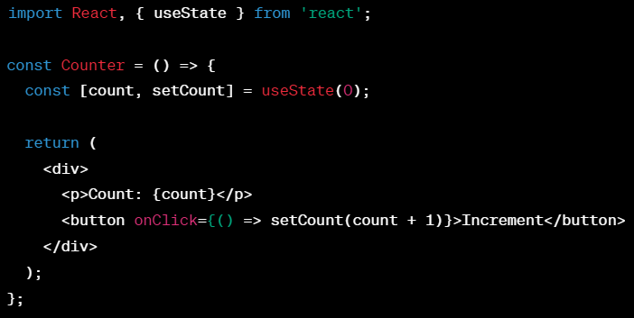
Hooks
Introduced in React 16.8, Hooks are functions that let you use state and lifecycle features in functional components.
Enables stateful logic in functional components.
Promotes code reuse and organization.
useState Hook
useEffect Hook
The useState hook allows us to create ​
state variables in a React function component. The state allows ​
us to access and update certain values in our components ​
over time.
useEffect lets us perform side effects ​ in function components. Side effects are actions that can ​ unpredictably change our component state ​ (that have caused 'side effects').​

Slide 10
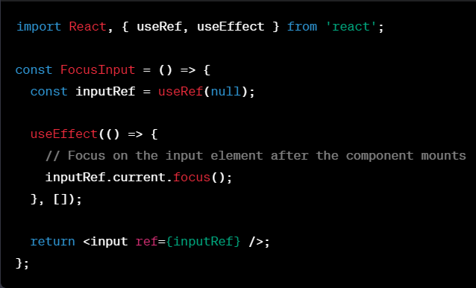
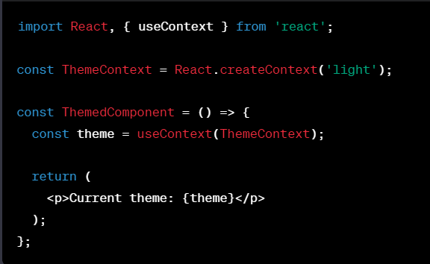
Hooks
useRef Hook
useContext Hook
useRef creates a mutable object with a .current property, allowing you to persist values across renders without causing re-renders.
useContext allows functional components to subscribe to React context without introducing a nested consumer.

Slide 11
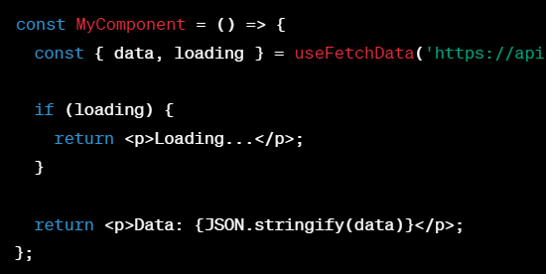
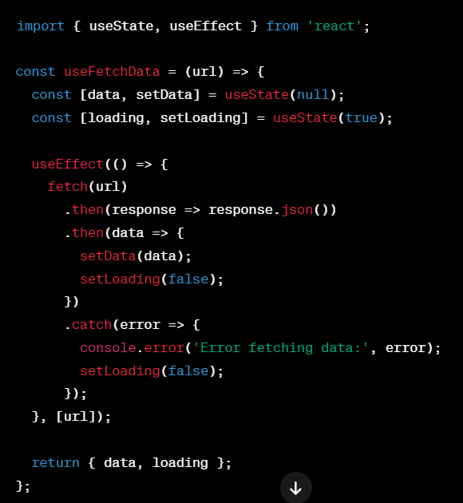
Custom Hook
Custom Hooks are user-defined functions that use React's built-in Hooks to encapsulate reusable logic.

Slide 12
Managing forms in React involves capturing user input and controlling the form's behavior.
Forms and Controlled Components
Forms play an essential role in modern web applications. They enable users to share information, complete tasks and provide feedback.​
Without forms, many of the tasks that we take for granted on the web, such as logging in, signing up, or making purchases, would not be possible.​

Slide 13
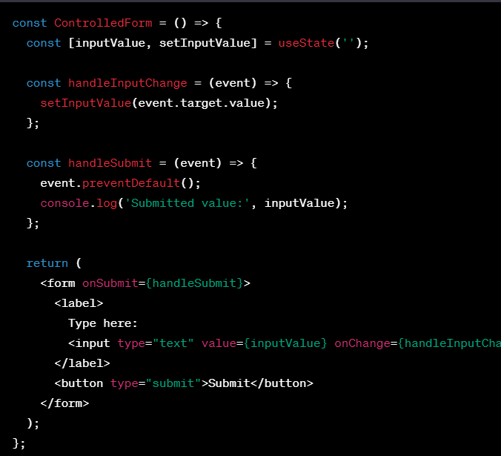
Controlled vs. Uncontrolled Components:
Controlled Components:
The React state controls values of form elements.
Provides a reliable and consistent way to handle form data.
Uncontrolled Components:
Form elements manage their state internally.
Generally not recommended in React, as it goes against the single source of truth principle.

Slide 14
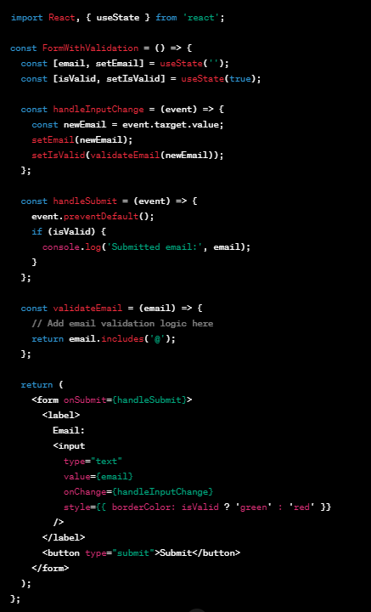
Form Validation:
Ensuring the entered data meets specific criteria before submission.

Slide 15
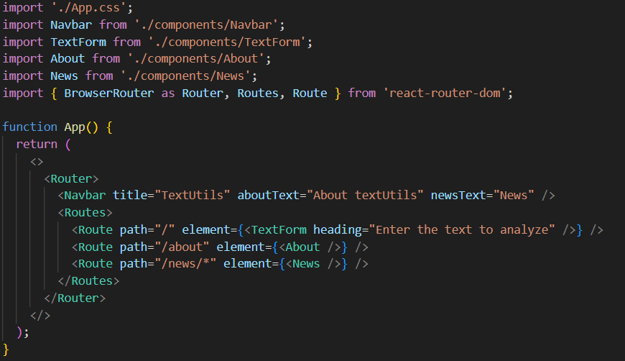
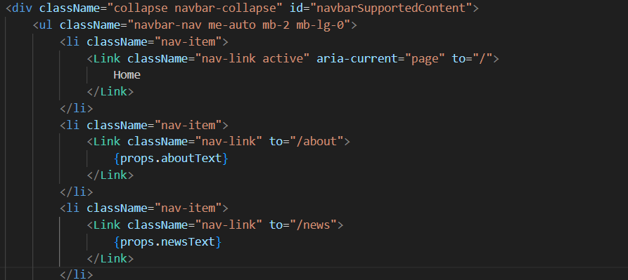
React Router for Handling Navigation
Routing in React involves using libraries like `react-router-dom` to enable navigation between different components or views based on the URL, creating single-page applications where content updates without full page reload.
React Router is a standard library for routing in React applications.
npm install react-router-dom

Slide 16
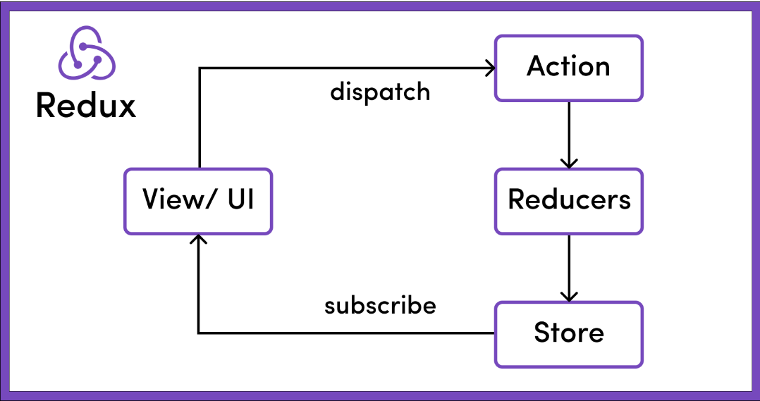
State Management (Redux)
Actions:
Plain JavaScript objects describing the change.
Reducers:
Centralized State:
Single source of truth for the entire application.
Stored in a single JavaScript object, commonly referred to as the "store."
Pure functions that specify how the application's state changes in response to actions.
Store:
Holds the complete state tree of the application.
Allows access to the state via getState().
Allows state to be updated via dispatch(action).
Middleware:
Functions that have access to actions and can perform side effects.
Common middleware: Thunk for asynchronous actions.

Slide 17



Action
Dispatched
Type: Bring
Payload: 1bat and 1ball
Action Creators
(Parents)
Reducer
(Care-Tacker)
UI Application
(Child)

Slide 18
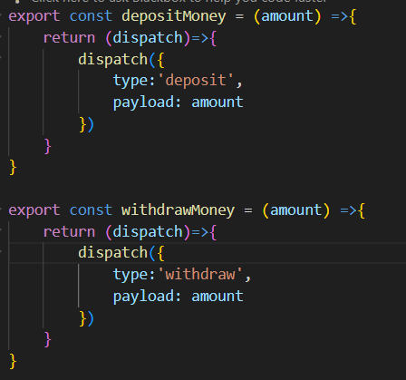
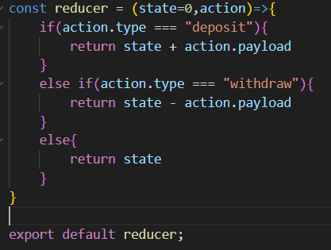
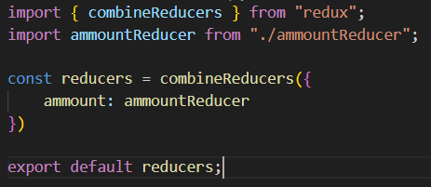
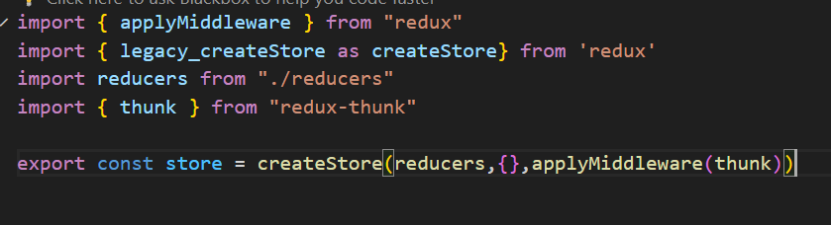
SBI (Example)
Action
Reducer
Shop

Slide 19
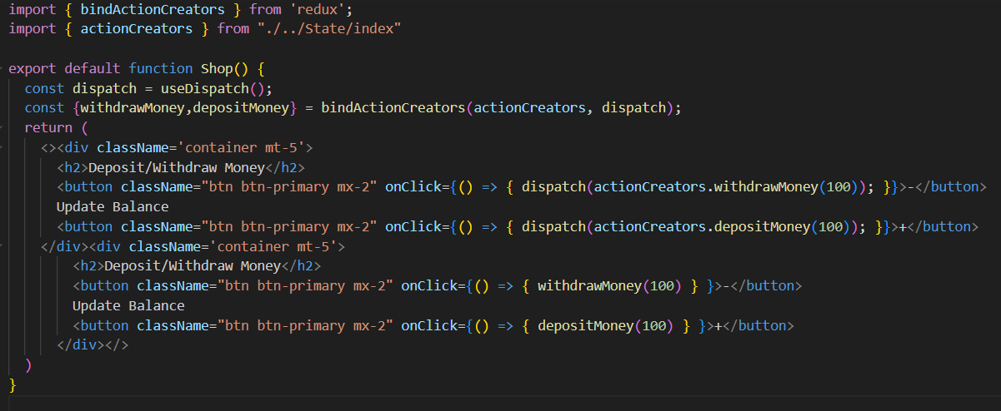
Shop

Slide 20
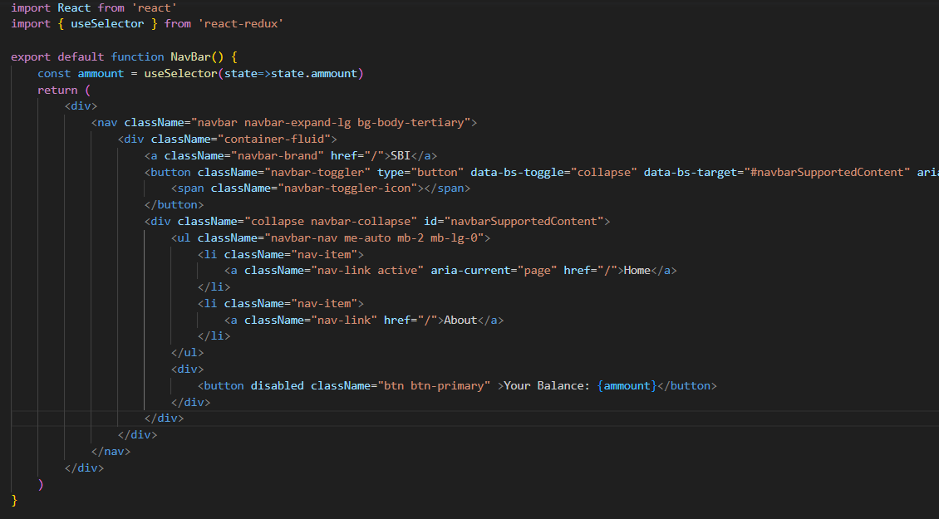
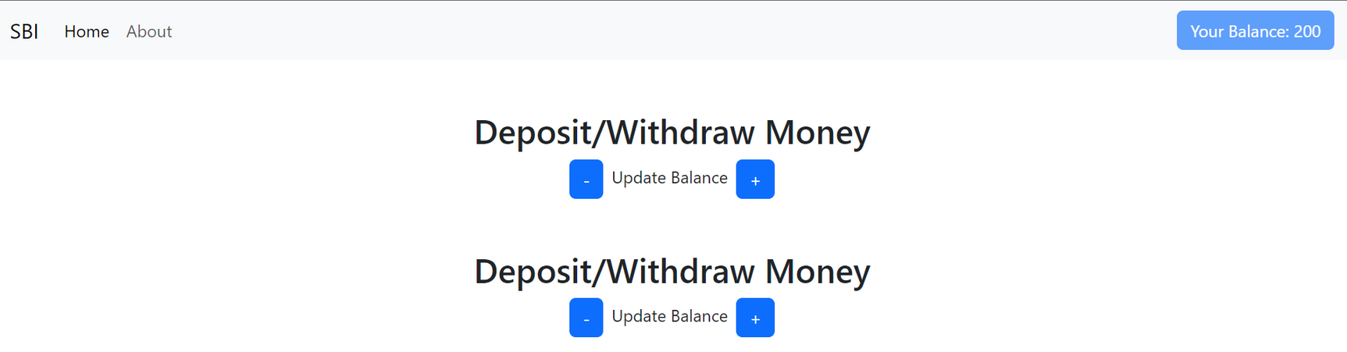
Screenshots

Slide 21
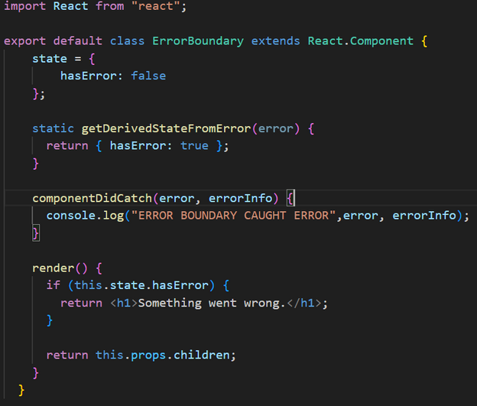
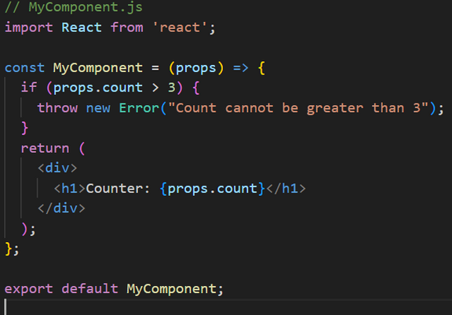
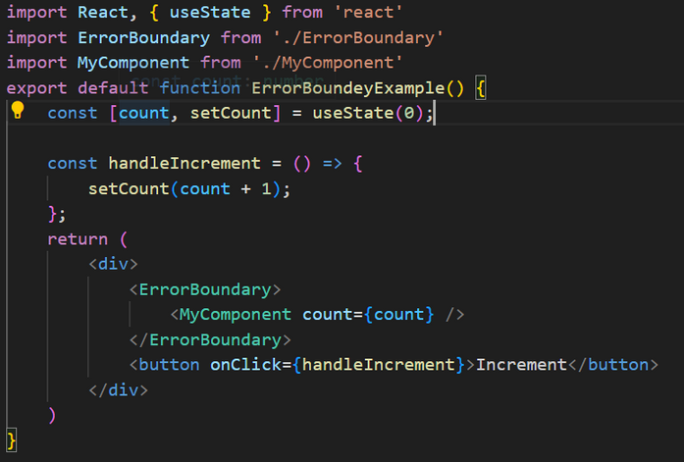
Error Boundaries
Error boundaries are components that catch JavaScript errors anywhere in their child component tree and log those errors or display a fallback UI.
Create a class component that extends React. Component and defines componentDidCatch method.
Wrap components or parts of the component tree with the created ErrorBoundary component.

Slide 22
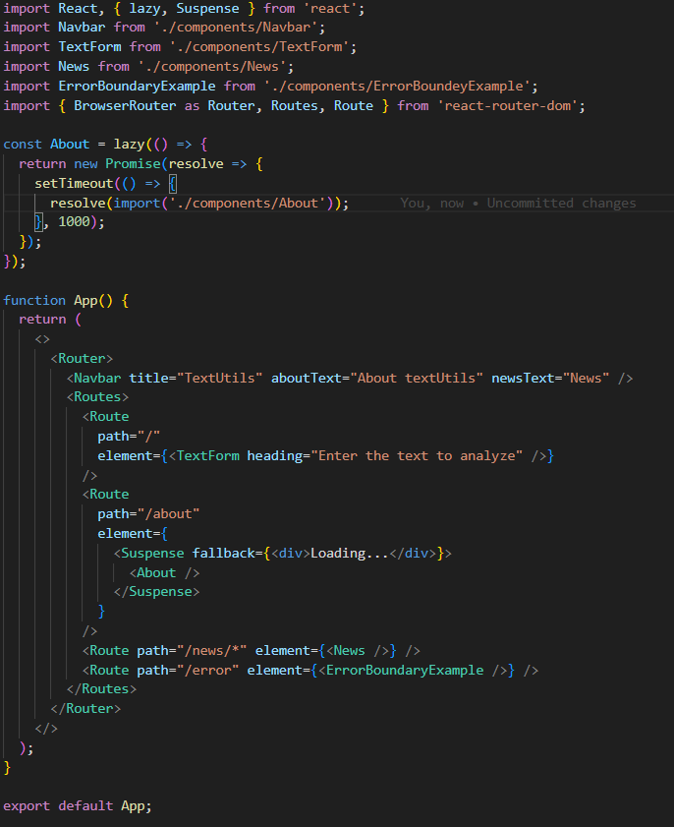
Code Splitting and Lazy Loading
Loading parts of the application only when they are actually needed.
A subset of code splitting, focused on deferring the loading of certain modules.
Commonly used for optimizing large single-page applications.

Slide 23
Questions....?

Slide 24
Thank you!

